Slide 1

3D Modeling Tool
Algorithmic Design Tool
3D Modeling Tool

Slide 2
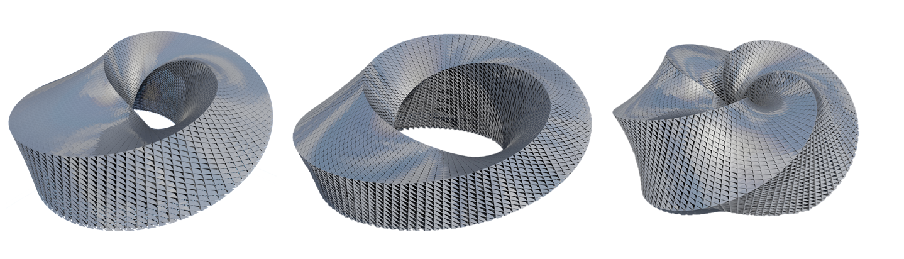

Slide 4
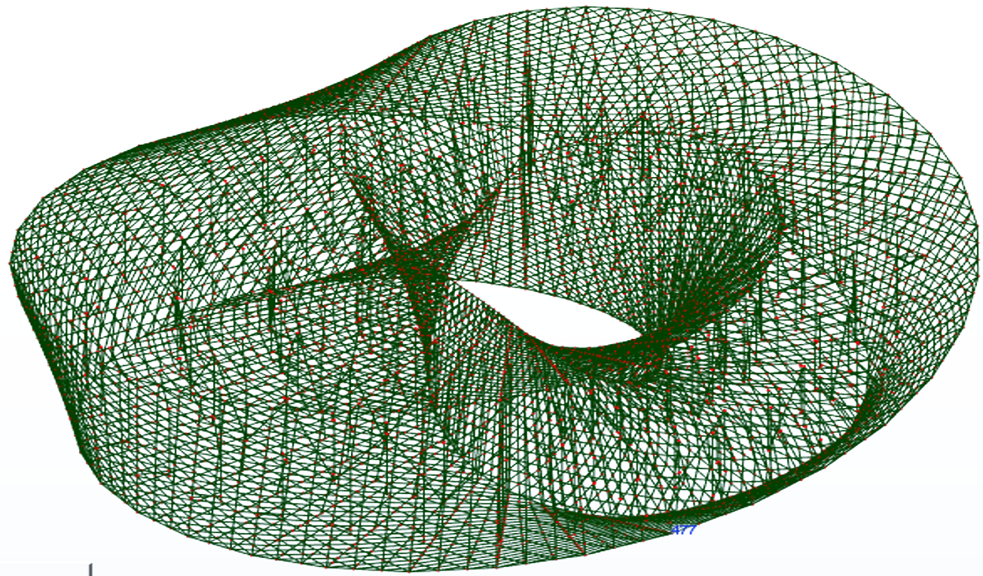
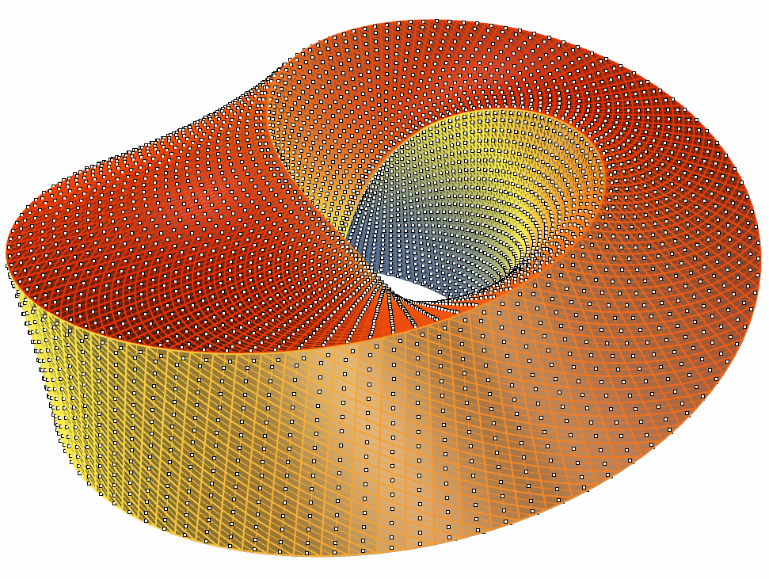

Slide 5
3D Modeling Tool
Algorithmic Design Tool
Analytical Tool 1
...
Analytical Tool n

Slide 6


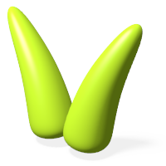


Grasshopper
Dynamo
Galapagos
Goat
Silvereye
Octopus
Opossum
Optimo

Slide 7
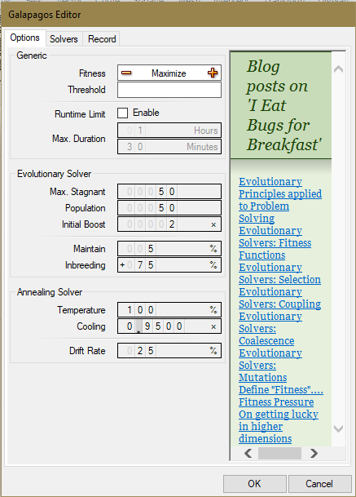
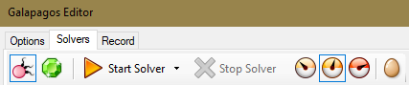
Galapagos
Fitness goal
Fitness goal threshold
Time Limit Options
Genetic Algorithm Solver
Simulated Annealing Solver
Solutions’ display options
Information about Galapagos
Genetic Algorithm
Parameters
Theoretical posts about evolutionary solvers
Simulated Annealing
Parameters

Slide 8
Galapagos
Fitnessgoal threshold
Time Limit Options
Genetic Algorithm Solver
Simulated Annealing Solver
Solutions’ display options
Information about Galapagos
Genetic Algorithm
Parameters
Theoretical posts about evolutionary solvers
Simulated Annealing
Parameters

Slide 9
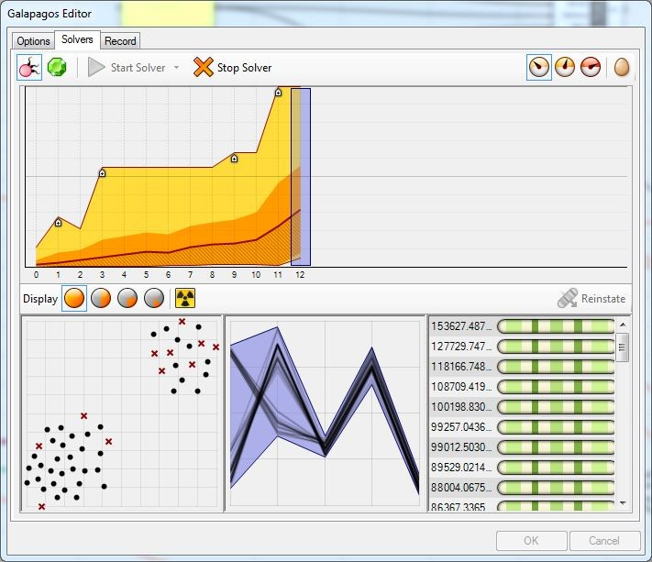
Galapagos
Genetic Algorithm Solver
Simulated Annealing Solver
Solutions’ display options
Version Information
Fitness goal
Fitness goal threshold
Time Limit Options
Better fitness value found
Population’s average fitness value
Genetic Algorithm
Parameters
Best Fitness found ever
Simulated Annealing
Parameters
Theoretical posts about evolutionary solvers

Slide 10
Galapagos Setup View
Objective Function Goal
Fitness goal threshold
Time Limit Options
Genetic Algorithm
Parameters
Simulated Annealing
Parameters
Theoretical posts about evolutionary solvers

Slide 11
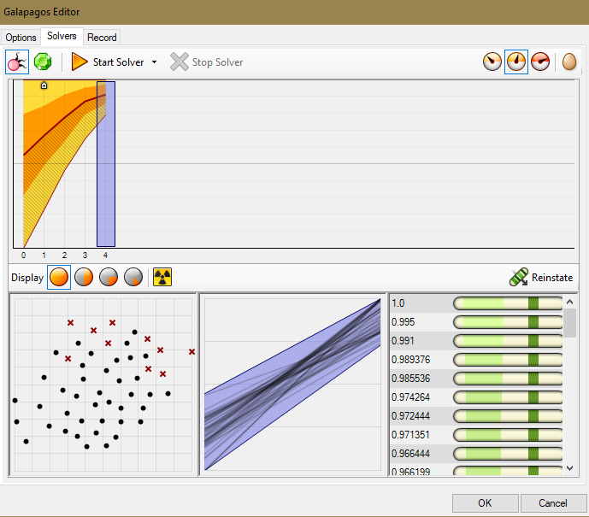
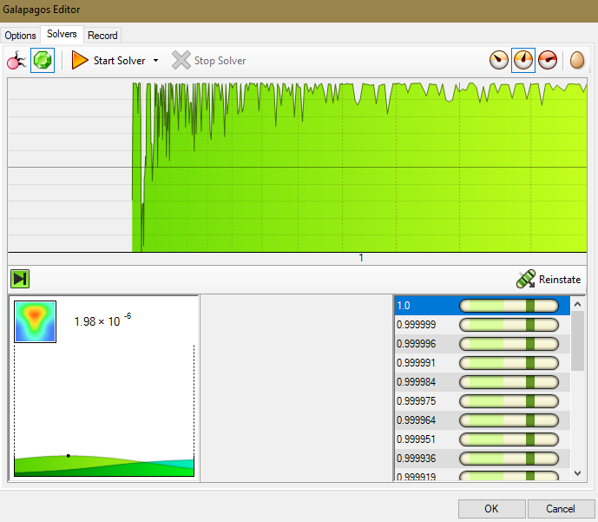
Galapagos – Results view

Slide 12
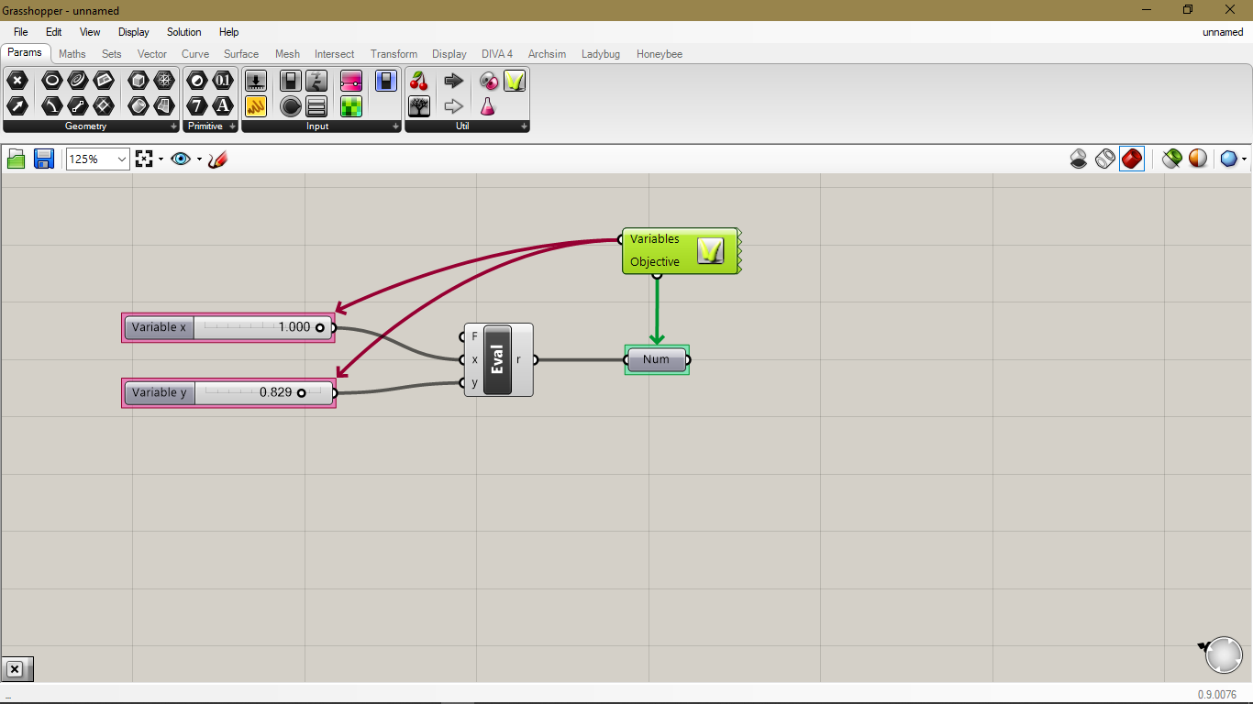
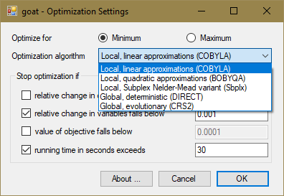
Goat

Slide 13
Octopus

Slide 14
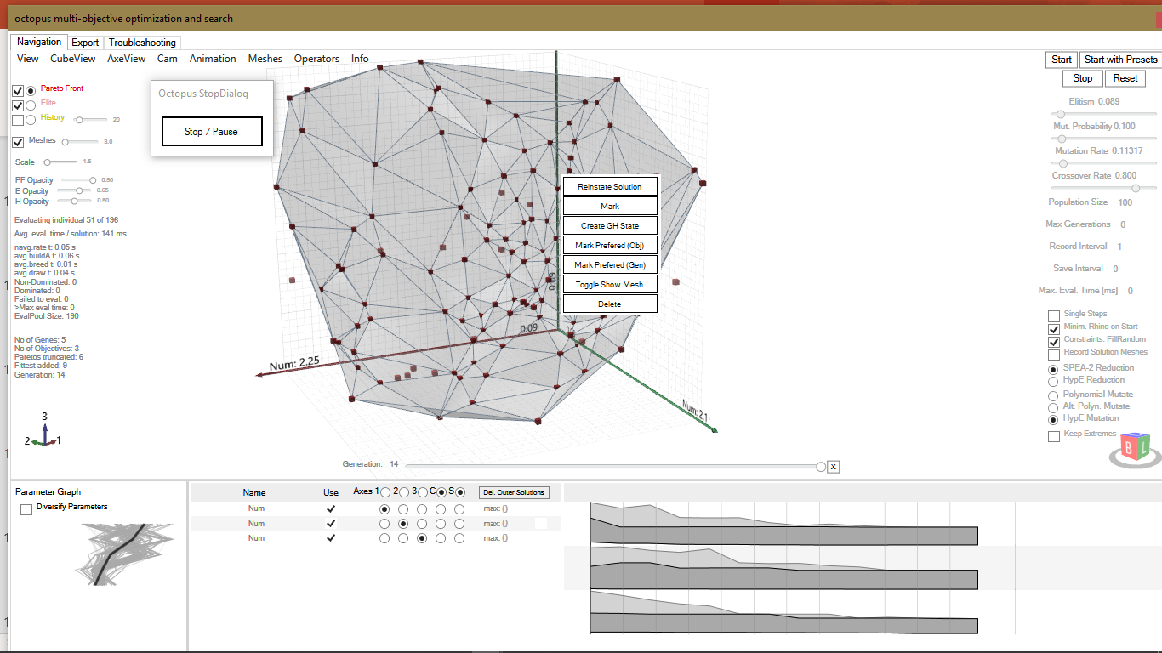
4
6
1
5
2
7
3
8
9
10

Slide 15
Optimo

Slide 16
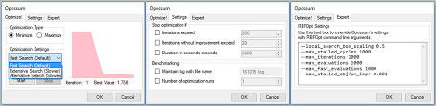
Opossum

Slide 17
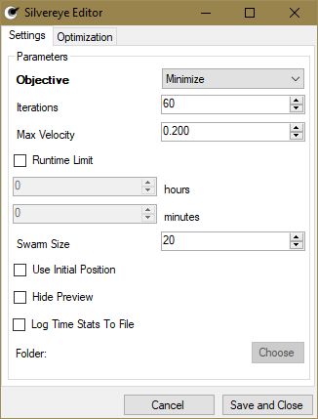
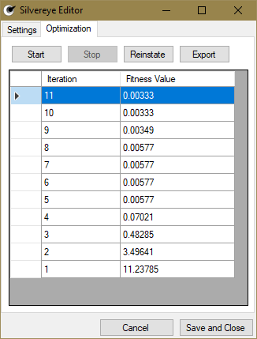
Silvereye

Slide 19
Solution

